Slide 1

SUBMITTED BY, NAME: Most. Sumaya akter Id: 180201077 Batch: 8th level : 2 , Term: II section: B Submitted to, tEACHER's name: Md. Toukir Ahmed degination: Lecturer signature: ……………..
Bangladesh Army University Of Science and Technology, Saidpur (BAUST)
Department: Computer Science and Engineering
Course code: CSE 2200
Course title: Software Development Project II
Project Name: Online student result processing system.

Slide 2
Online student result processing system
Objective :
Introduction
Some features of software
Hardware Requirements
Software Requirements
Installation Instructions
Some snapshots
Rerefarence

Slide 3
Online student result processing system
INTRODUCTION:
The need to computerize students' results processing arose due to problems such as duplication of results, loss of results when files are being carried around, wrong calculations during computation and omission of result which are encountered frequently. Using this application, the school, college, univarsity management would ensure that results are processed faster, without delays and with fewer errors.

Slide 4
Online student result processing system
Some features of the software
Student:
Search result
Admin:
Student add
Student delete
Add subject
Delete subject

Slide 5
Online Student result processing system
Hardware Requirements:
1. A minimum of Pentium 4 with a speed of 1.3 GHz. 2. A minimum RAM capacity of at least 512MB. 3. Hard disk capacity of at least 100mb free space.

Slide 6
Online student result processing system
Software Requirements: 1. Windows 7,8,10 and above 2. XAMPP v3.2.2 and above 3. Web Browser (Opera or Chrome)

Slide 7
Online student result processing system
Installation Instructions: 1. Extract the package folder 2. Copy the folder to C:\xampp\htdocs 3. Create a new database in localhost/phpmyadmin and import the SQL file in the folder

Slide 8
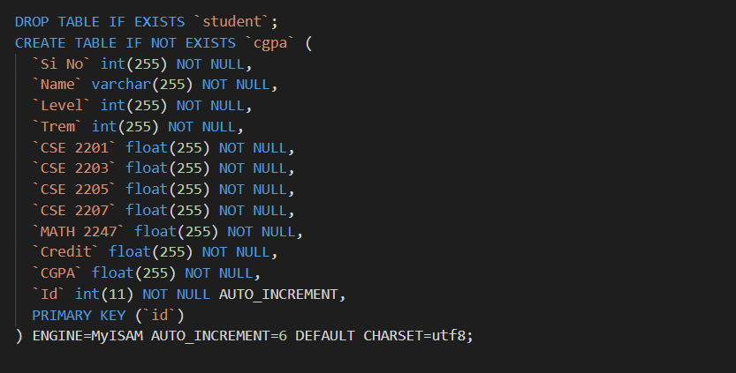
Online student result processing system
Some Snapshots:
Database:

Slide 9
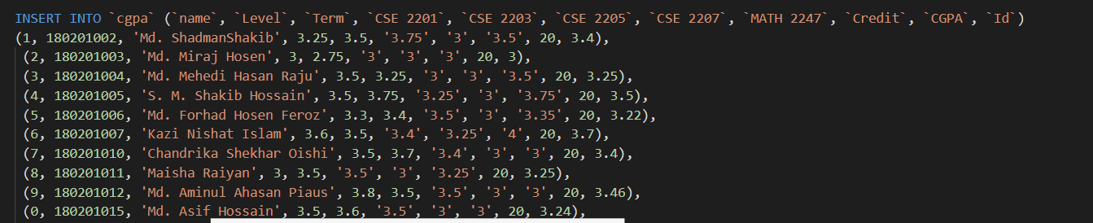
Online student result processing system
Database csv file insert:

Slide 10
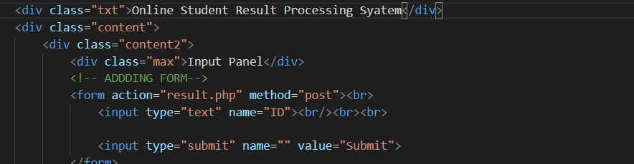
Online student result processing system
Input panel:

Slide 11
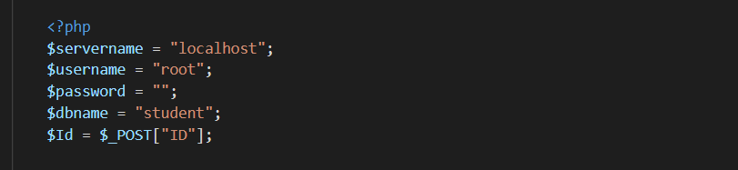
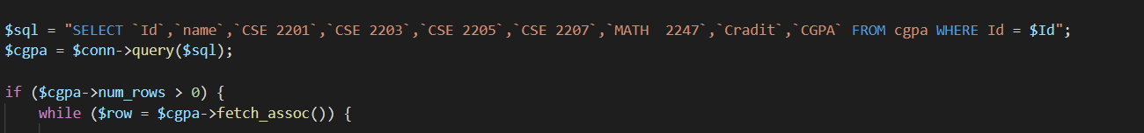
Online student result processing system
Connection:
SQL injection:

Slide 12
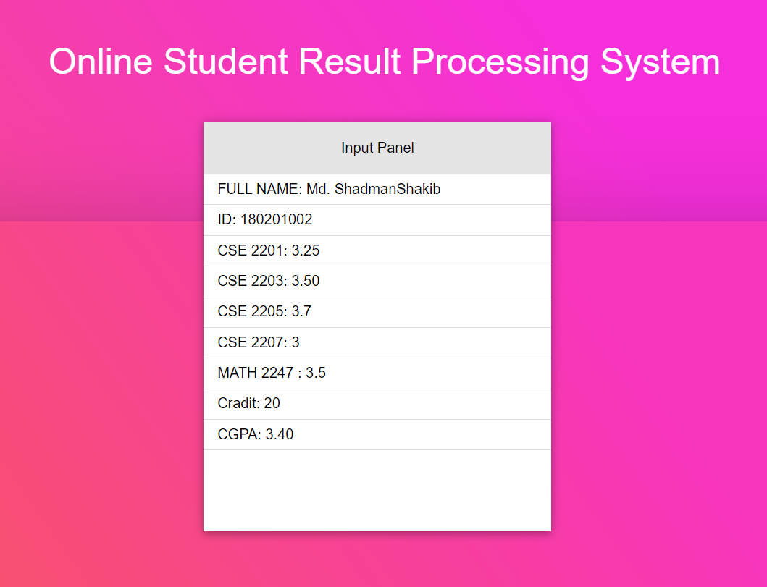
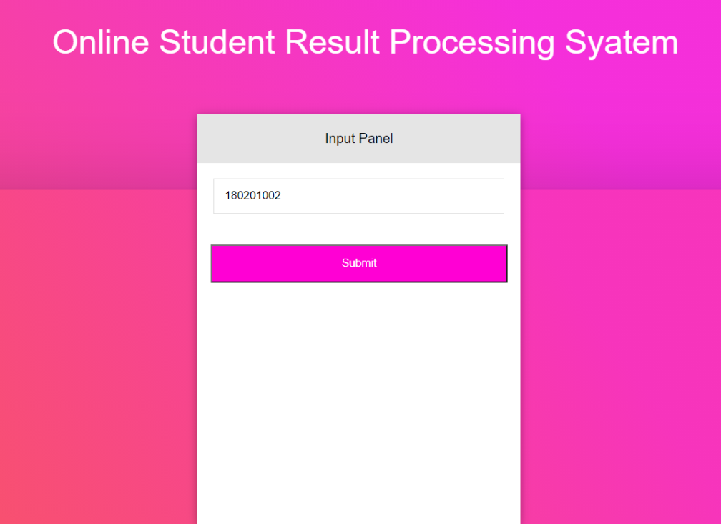
Online student result processing system
Output:

Slide 13
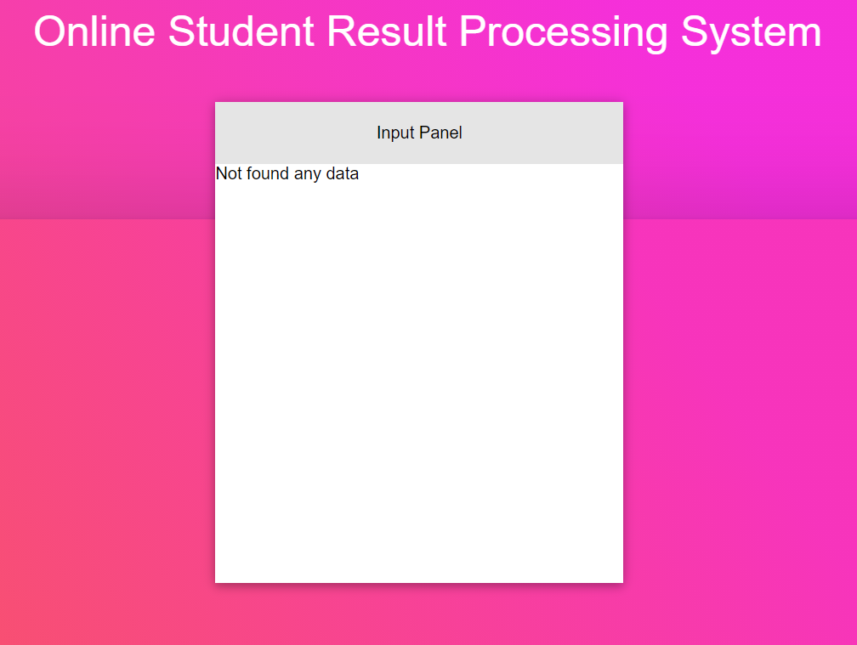
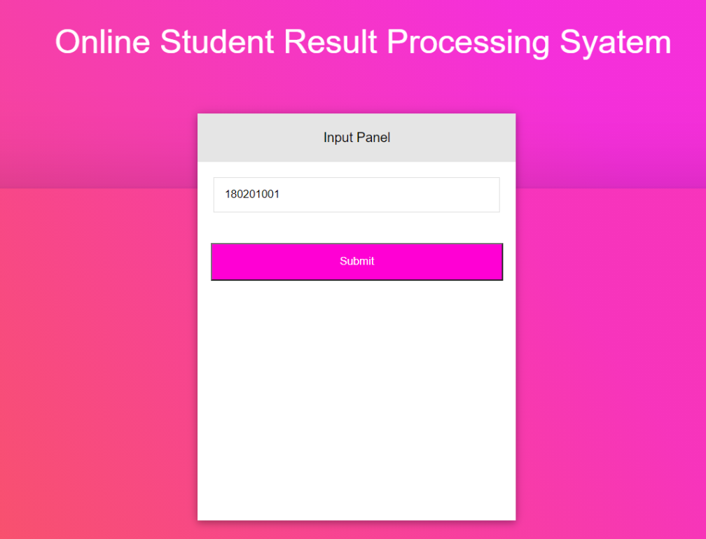
Online student result processing system
Output error (not data insert input):

Slide 14
Online student result processing system
Reference:
Github:
https://github.com/Sumaya234/Online-result-processing-system/tree/main

